Slide 1
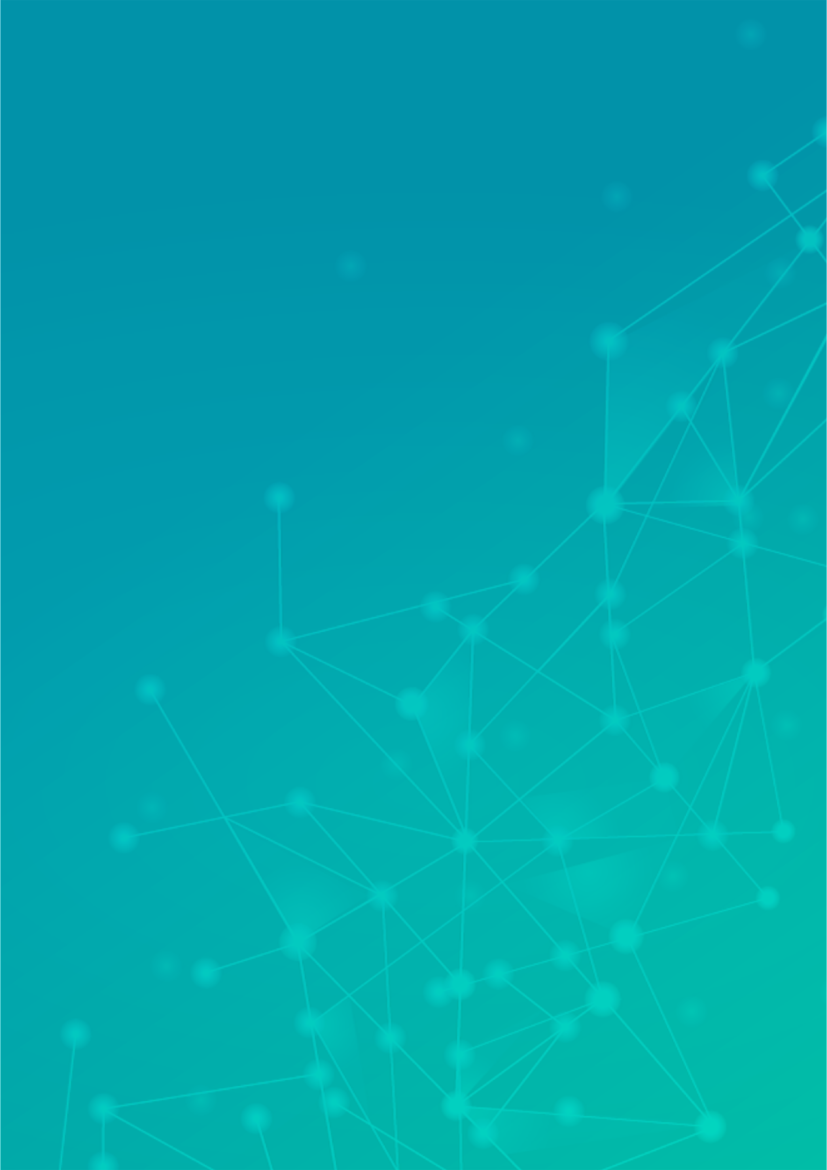
ISL Translation App
User Manual
Author: Arjun Sharma
Notes:
Preworks course home assignments

Slide 2
Table of Contents
Acknowledgements
About me
About my internship journey
About my app
How to use the app
Demo

Slide 3
Acknowledgements
Thank you to the wonderful people at Clevered for teaching us how to use the different libraries to create our own project.

Slide 4
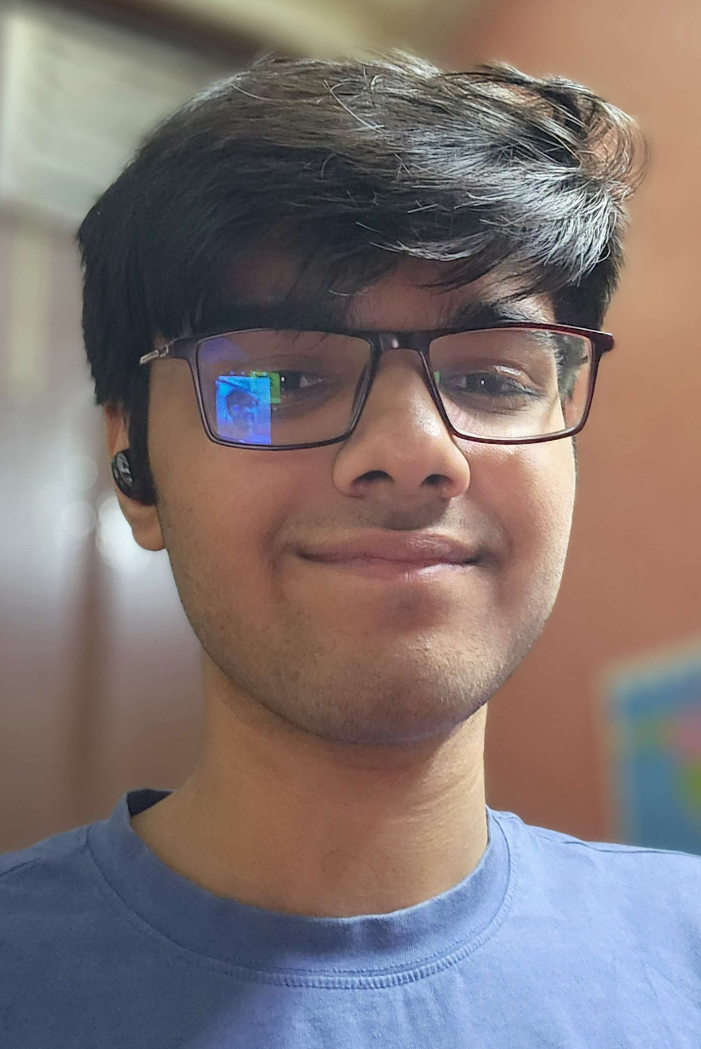
About Me..
Name – Arjun Sharma
Age – 16
Hobbies & Interests:
- Astronomy & Nuclear physics
- Gaming
- Mathematics
- Music
- Geography
- History
- Global politics
- Coding

Slide 5
About My Internship Journey with Clevered..
Over the last couple of months, I’ve learnt a lot in this internship and improved my understanding of AI.

Slide 6
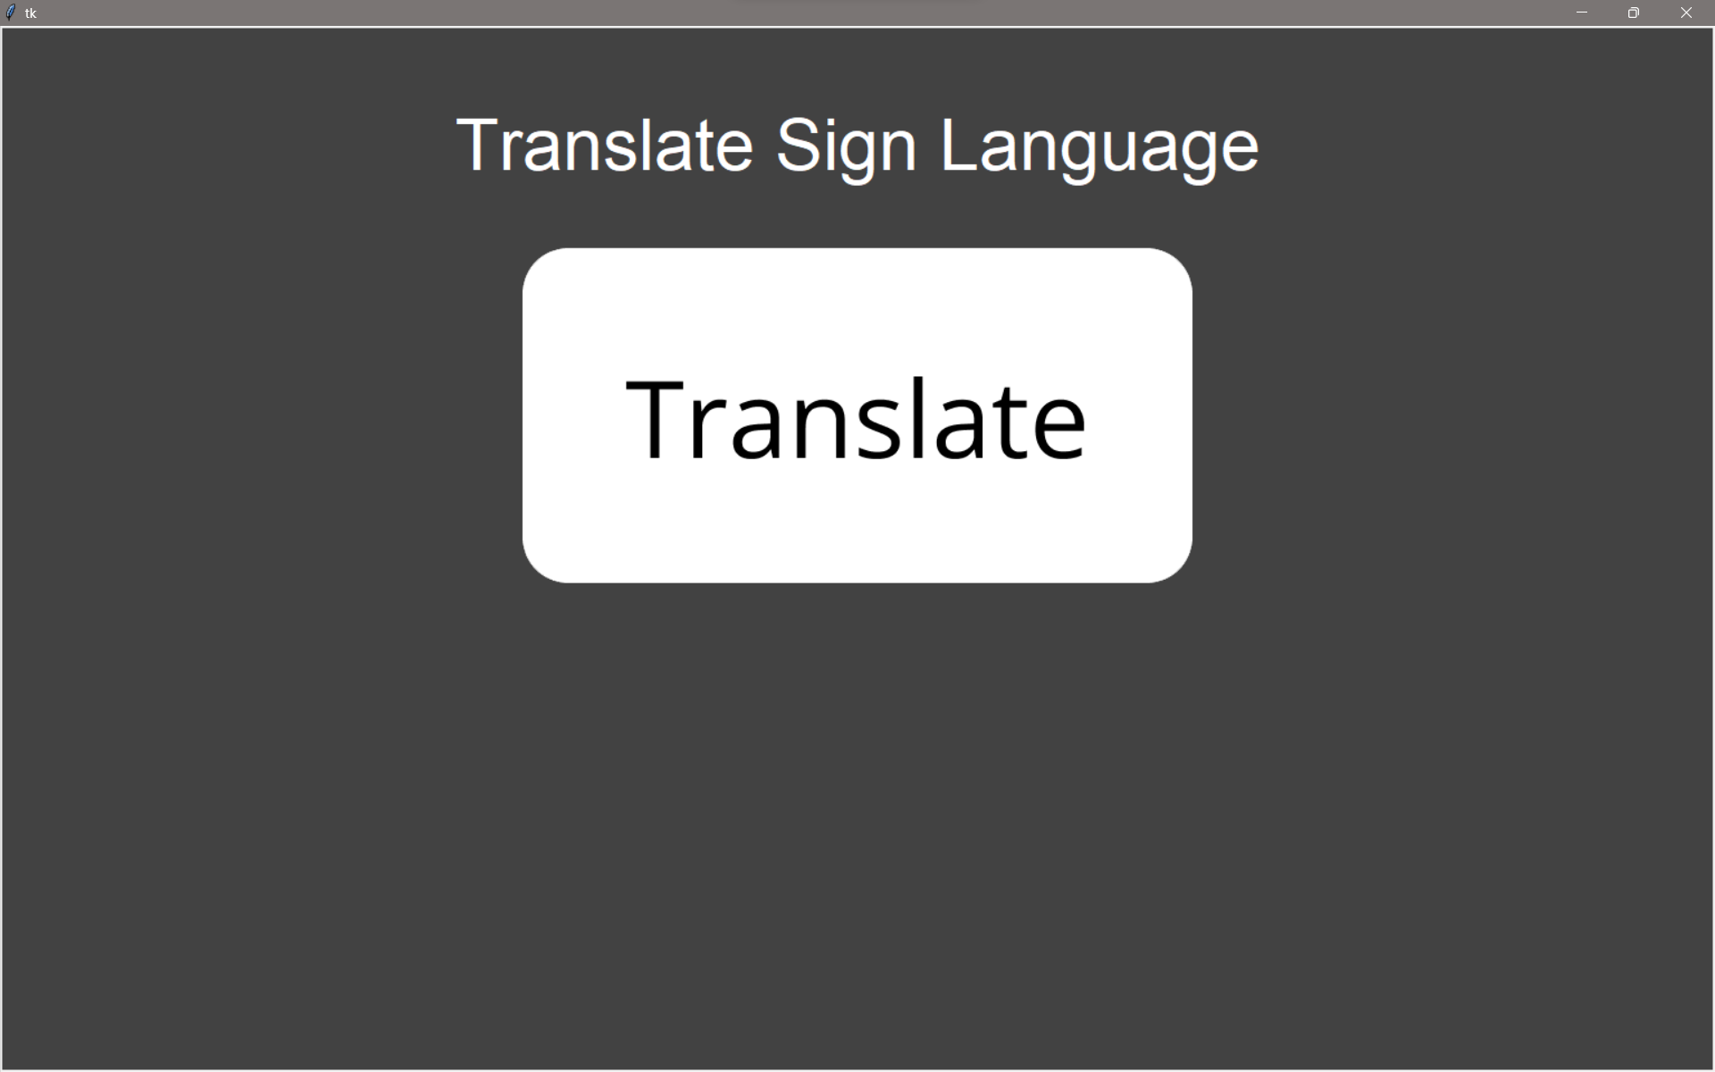
About my App..
My app uses AI to translate an ISL image into its textual translation.
This is done by using the TensorFlow library to train a model on a dataset of ISL letters that can then be used to translate image inputs.

Slide 7
How do I use the App?

Slide 8
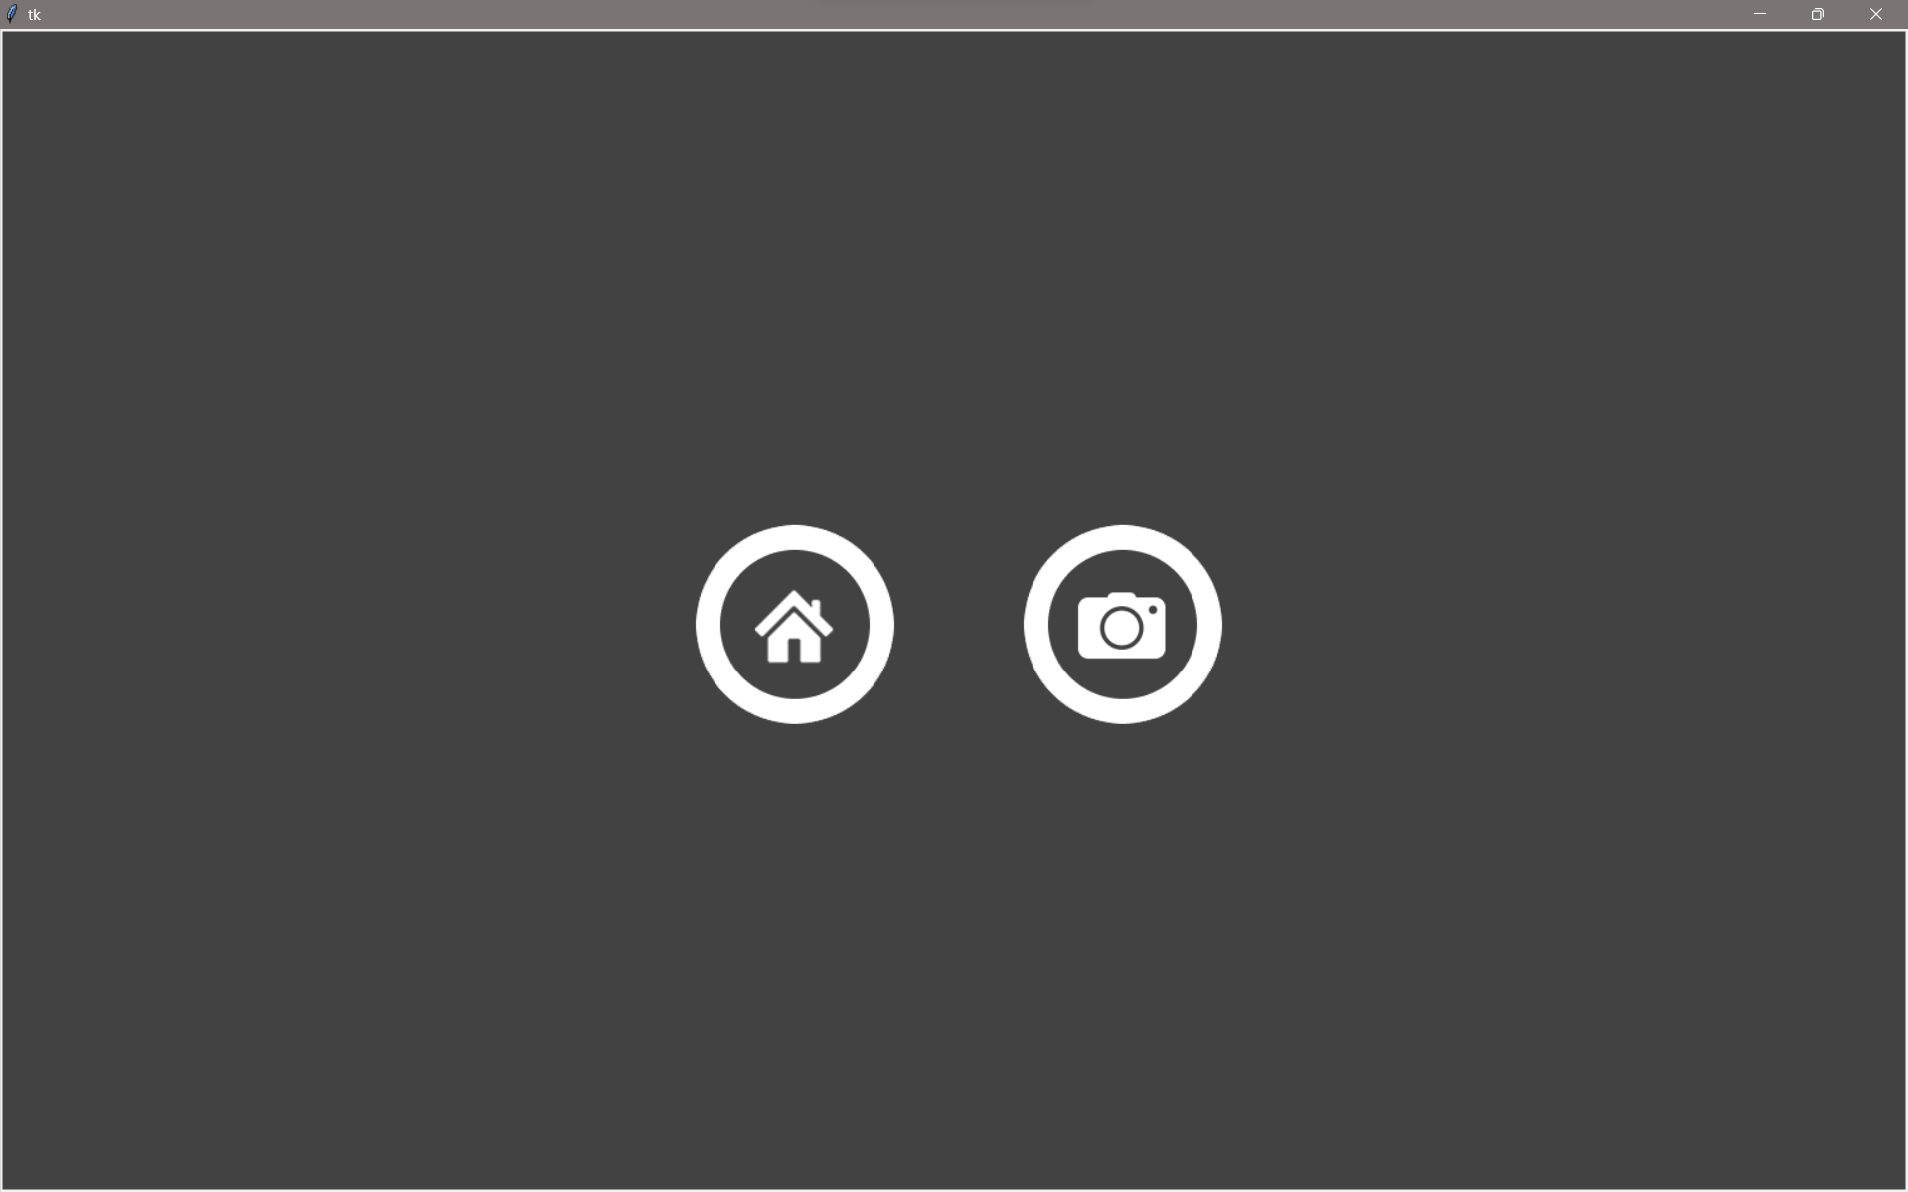
Option Name(This will be repeated for each option of the App)
This is the screen of the app that is used to translate the sign language to text.
Home button – Return to the home screen
Camera button – Open a file explorer tab to select a file to upload to the app so it can be analyzed.

Slide 9
Contact Person
You can reach out to me at:
arjun.sharma10@outlook.com
+91 9999473896

Slide 10
Thank you!

